Slide 1

FollowUpAR: Enabling Follow-up Effects in Mobile AR Applications
Jingao Xu*, Guoxuan Chi*, Zheng Yang, Danyang Li, Qian Zhang
Qiang Ma, Xin Miao
School of Software and BNRist, Tsinghua University
http://jingao-xu.info
ACM MobiSys 2021
Notes:
[START] Hello everyone, I’m Jingao from Tsinghua university.
Today, I’ll talk about our recent work, “FollowUpAR: Enabling Follow –up effects in mobile AR applications”
This work is working with my collaborator Guoxuan, Danyang, Qian and under supervision of prof. Zheng Yang

Slide 2
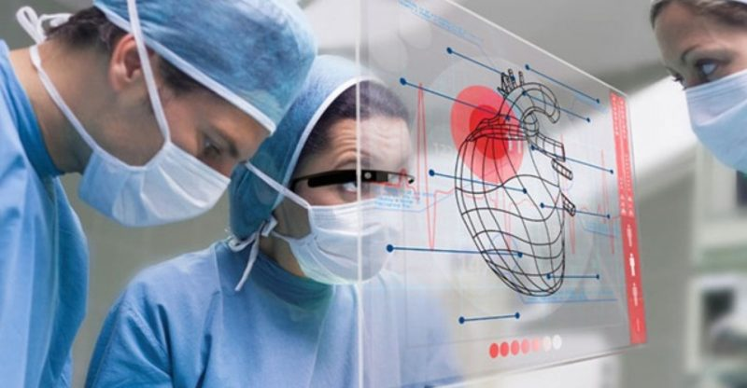
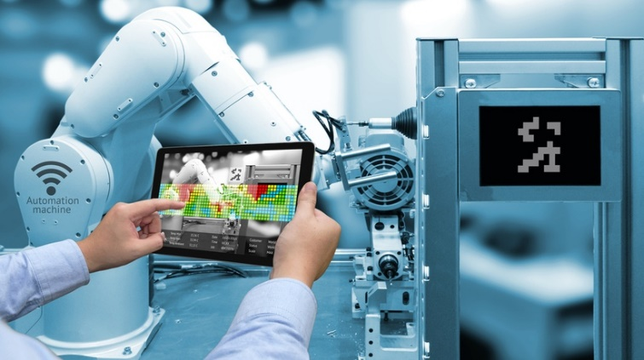
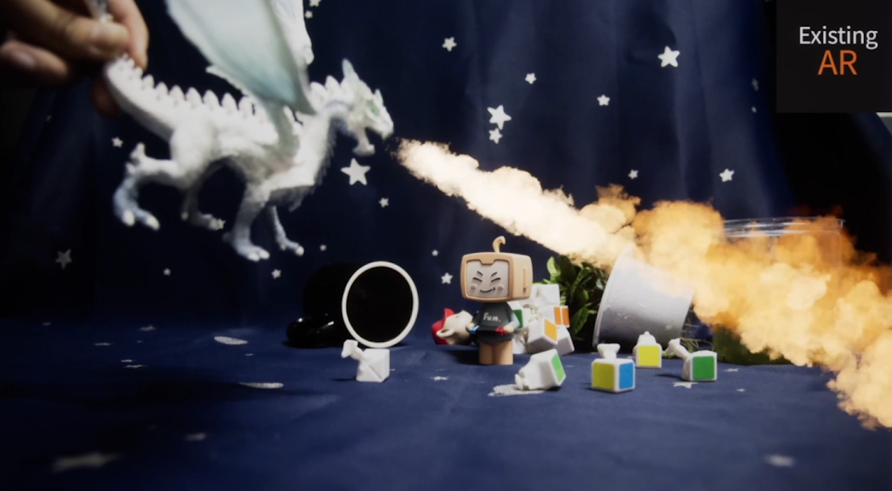
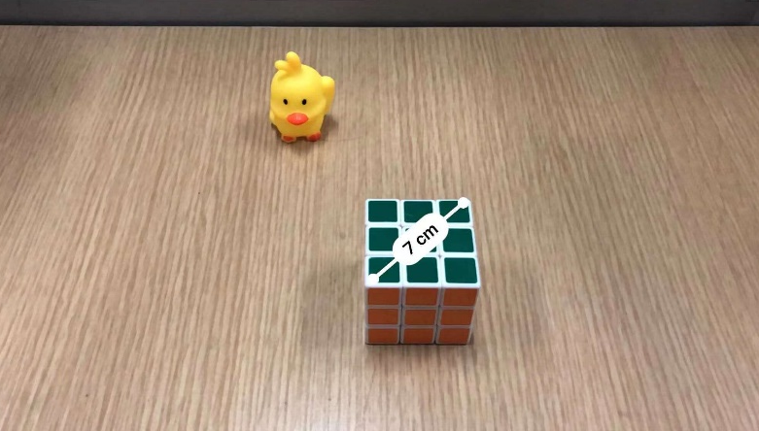

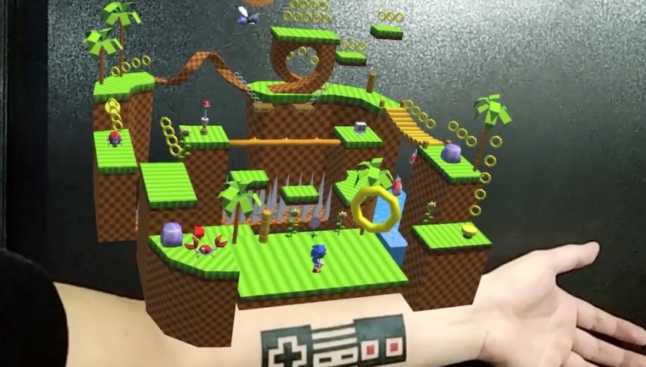
Background
Mobile Augmented Reality
Anchor Object: Dragon
Virtual Effect: Flame
Health Care
Industry
Google ARCore
Virtual Effect: Measurements
Anchor Object: Cube
Education
Game
Apple ARKit
Notes:
[START] Augmented Reality, enhances the real world by rendering virtual effect on users’ field of view through cameras.
Nowadays, AR has provided immersive experiences in entertainment, education, health care, even industrial production.
[CLICK] There are also some well-known AR solutions such as Google ARCore and Apple ARKit. They allow a user to select an anchor object and attach related virtual effects on it.
[CLICK] For instance, when a user selects a dragon, a virtual flame will be attached to the dragon’s mouth.
Similarly, in the ruler application on the iPhone, we can also attach some measurements on a cube.

Slide 3
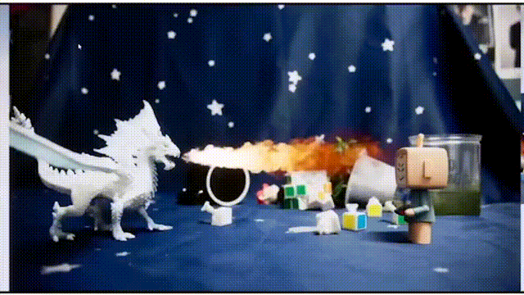
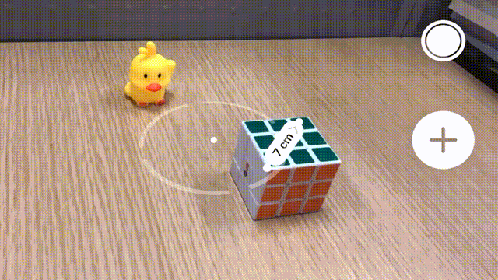
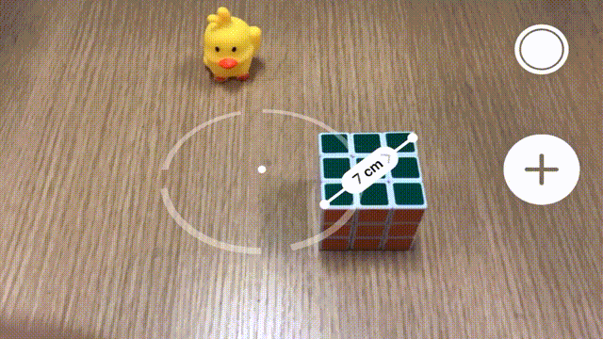


Background
Existing Mobile AR Solutions
Google ARCore
Apple ARKit
If the object keeps static, they are good of tracking
user’s/camera’s motion and view virtual effects from any angle
Lack the ability to render follow-up effects to moving objects.
Notes:
[START] Arcore and ARKit are able to continuously track the motion of the smartphone to adjust the effect.
For example, as seen in the demo, when we move the iPhone slowly and keep the cubic stationary, the virtual measurement result will change its location and orientation.
[CLICK] However, once we change the location of these anchor objects, the virtual effects will misalignment and hence the whole view is distorted.
For instance, the virtual flame and measurements do not follow the dragon and cube’s motion.
In a nutshell, today’s mobile AR solutions lack the ability to render follow-up effects to moving objects.

Slide 4



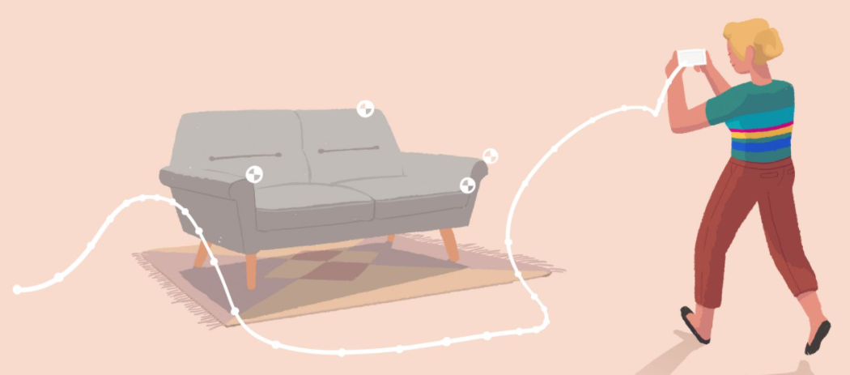
Motivation
Why Existing Mobile AR Solutions Cannot Render Follow-up Effects?
Allows the phone to estimate the environment's current conditions and render effects
They assume anchors/surfaces are static and lack the ability to track the 6-degree-of-free (6-DoF) Pose¹ of them!
Environmental understanding
System
Architecture
of
ARCore
Allows the phone to detect the size and location of all type of static surfaces/anchors
Plane/Anchor detection
Pose tracking of anchors is key to further bridge the gap between virtuality and reality!
Allows the phone to track its position relative to the world
Camera Motion Tracking
¹Pose = Location (3-DoF) + Orientation (3-DoF)
Notes:
[START] So why existing mobile AR solutions cannot render follow-up effects?
Let’s dig into the system architecture of ARCore.
ARCore is equipped with three key capabilities, including Camera Motion Tracking, Plane/Anchor Detection and Environmental understanding.
Let’s focuse on the Plane/Anchor detection, it allows smartphones to find the suitable place to render the virtual effects
[CLICK] However, the core issues is that they assume anchors or surfaces are static and lack the ability to track the 6-DoF pose of them.
Hence they cannot render follow-up virtual effects to them.
[CLICK] In a nutshell, we think pose tracking of anchors is key to further bridge the gap between virtuality and reality.
Note that in our work, object’s 6-DoF pose is a combination of its location and orientation

Slide 5
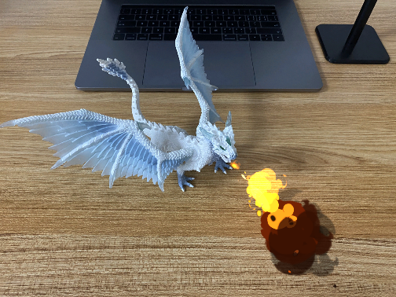
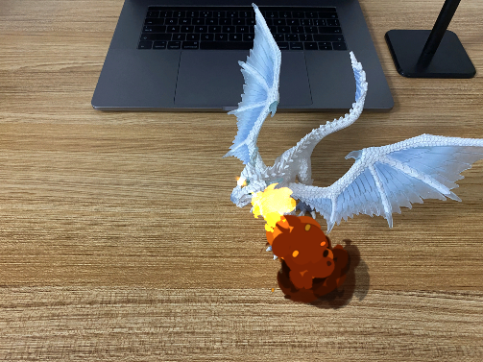
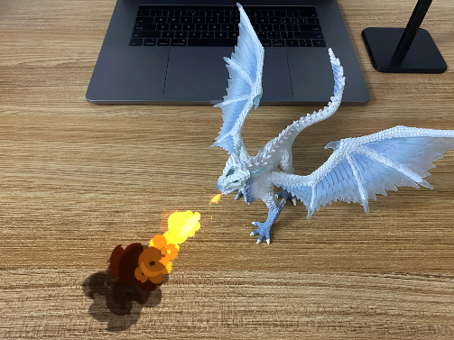
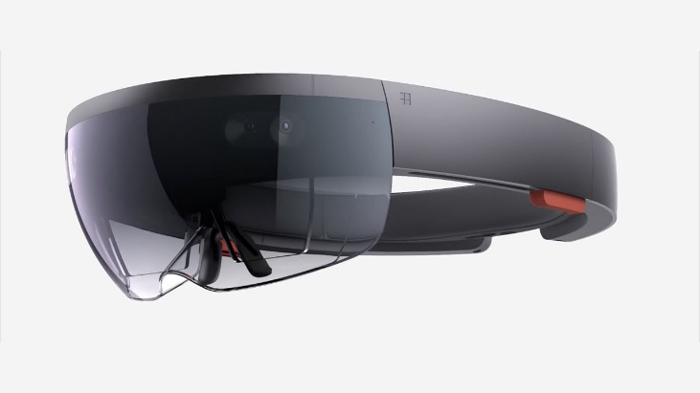
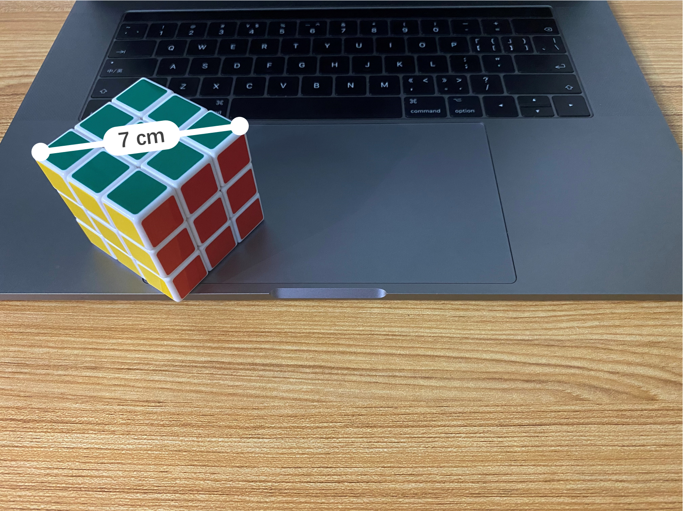
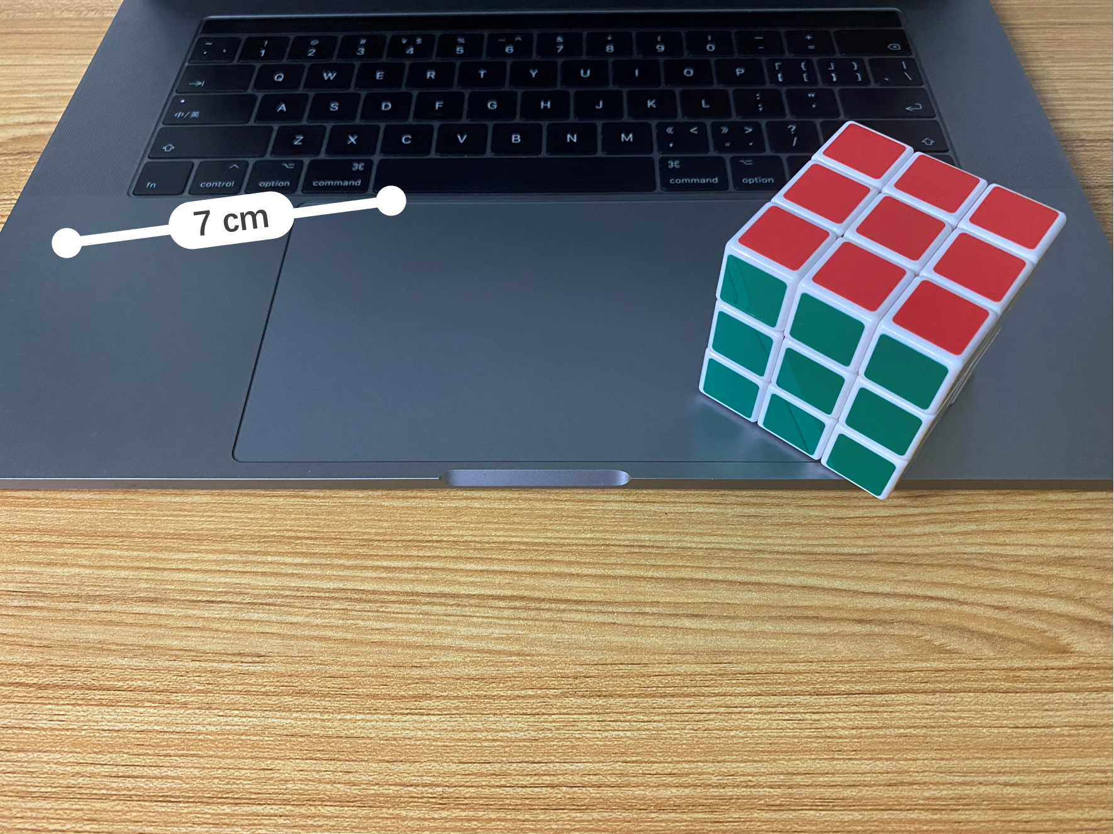
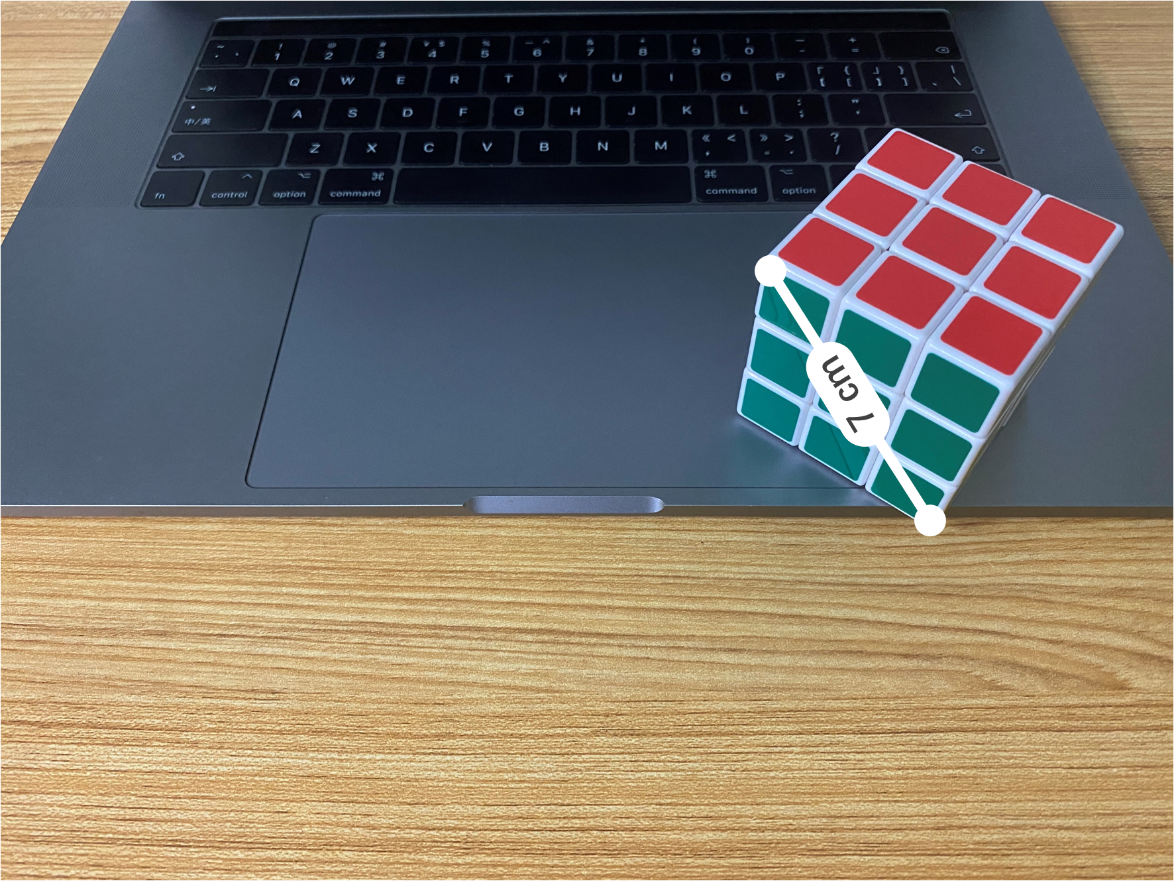
Related Works
How Do Related Works Track the Object’s 6-DoF Pose?
1.Sophisticated Sensors Based Solutions
Expensive sensors or devices are not concurrently available on commercial smartphones!
Color RGB * 2
Grey * 1
Depth * 2
IR * 2
Initial Effect
ARCore
Notes:
[START] So next, let’s take a glance at how existing works track the object’s 6-DoF pose?
First, leveraging expensive and sophisticated sensors or devices.
For example, Microsoft hololens are equipped with 4 different types of cameras.
[CLICK] However, these expensive sensors are not simultaneously available on commercial smartphones.

Slide 6
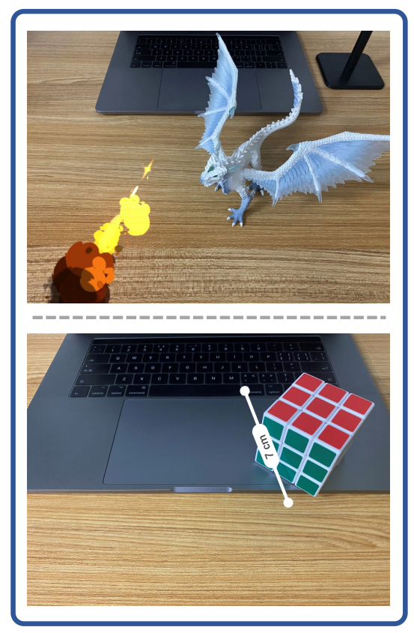
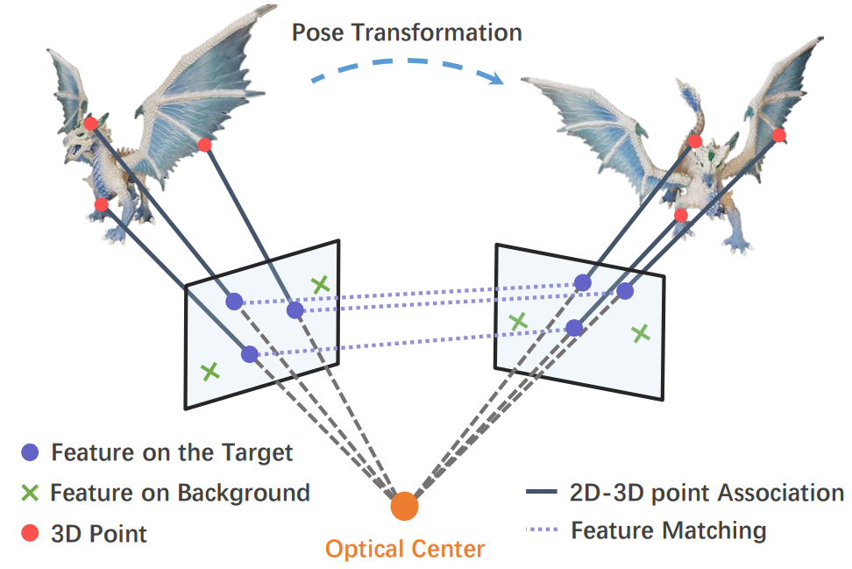
Related Works
How Do Related Works Track the Object’s 6-DoF Pose?
2.Classcial Feature Matching Based Solutions
Cumulative drift leads to virtual effects misalignment!
Initial Effect
ARCore
Rusinkiewicz, S, et al. “Efficient variants of the ICP algorithm”. In Proceedings third international conference on 3-D digital imaging and modeling. IEEE. 2005.
Mur-Artal R, et al. “ORB-SLAM: a versatile and accurate monocular SLAM system”[J]. IEEE transactions on robotics, 2015
Notes:
[START] Second, classical visual feature matching based object pose tracking.
[CLICK] However, the cumulative drift and low precision leads to virtual effects misalignment

Slide 7
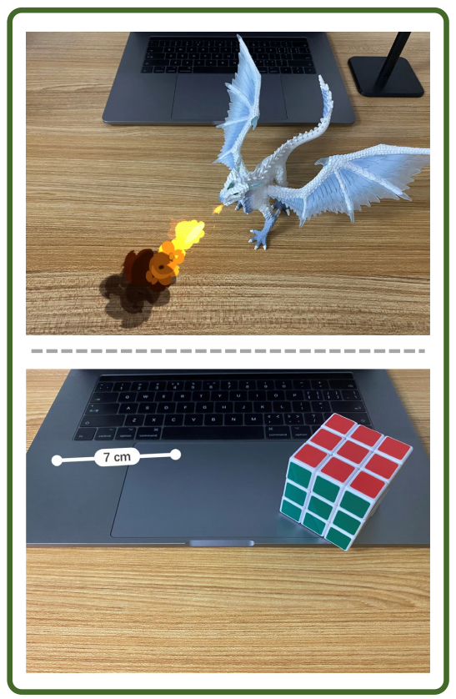
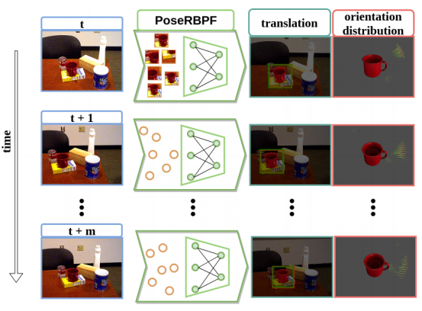
Related Works
How Do Related Works Track the Object’s 6-DoF Pose?
3.Deep Learning Based Solutions
Can neither track arbitrary objects nor run on phones in real-time!
Pre-training of the network
Pre-modeling of the target
Initial Effect
ARCore
Deng X, et al. “PoseRBPF: A Rao–Blackwellized Particle Filter for 6-D Object Pose Tracking”[J]. IEEE Transactions on Robotics, 2021.
Xiang Y, et al. “Posecnn: A convolutional neural network for 6d object pose estimation in cluttered scenes”[J]. CVPR, 2017.
Notes:
[START] Third, deep-learning-based methods.
Although the tracking performance of these solutions meets the demand of AR applications.
These approaches require complex pre-modeling of specific objects and pre-training of neural networks in advance.
[CLICK] They can neither track arbitrary objects nor run on phones in real-time.

Slide 8
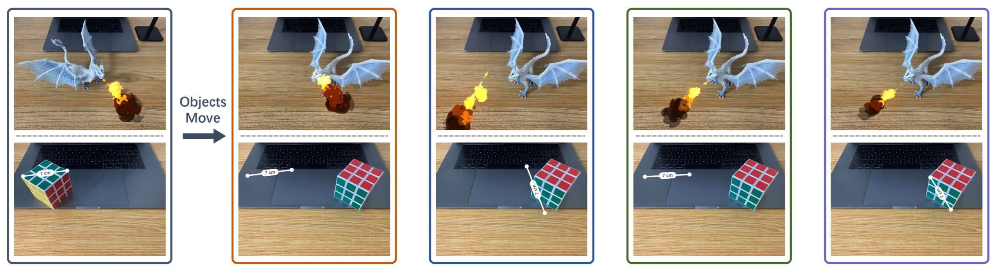
Our Work
How About Our Work?
Our work, FollowUpAR, can track object’s 6-DoF pose in real-time on commercial smartphones!
Initial Effect
ARCore
Feature-based
Tracking
Learning-based
Tracking
※Our Work
Notes:
[START] So in summary, none of previous solutions can be used on smartphones in ubiquitous scenarios.
[CLICK] In this work, Our goal is to track object’s pose in real-time on commercial smartphones without pre-training.

Slide 9
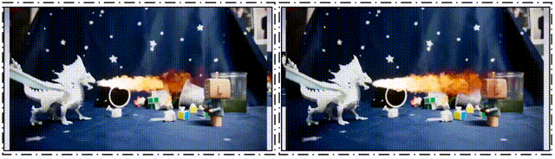
Our Work
How About Our Work?
Environmental understanding
Plane detection
Anchor Pose
Tracking
Plane detection
ARCore
FollowUpAR
FollowUpAR provides ARCore with the Anchor Pose Tracking function and enable smartphones to render follow-up effects!
Camera Motion Tracking
Notes:
[START] Furthermore, let’s recall the system architecture of ARCore
[CLICK] FollowUpAR provides ARCore with the Anchor Pose Tracking Function
[CLICK] And eventually, enable smartphones to render follow-up virtual effects.
The running demo of FollowUpAR from a Google Pixel 4 is shown in the above video.

Slide 10
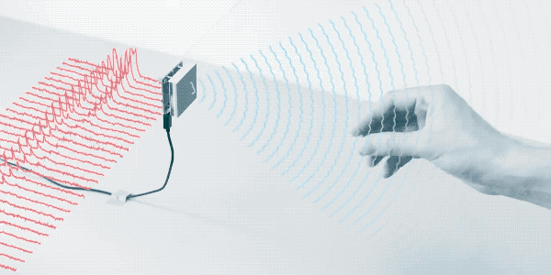
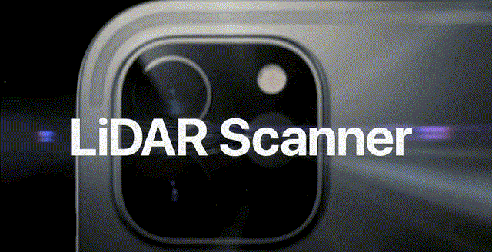
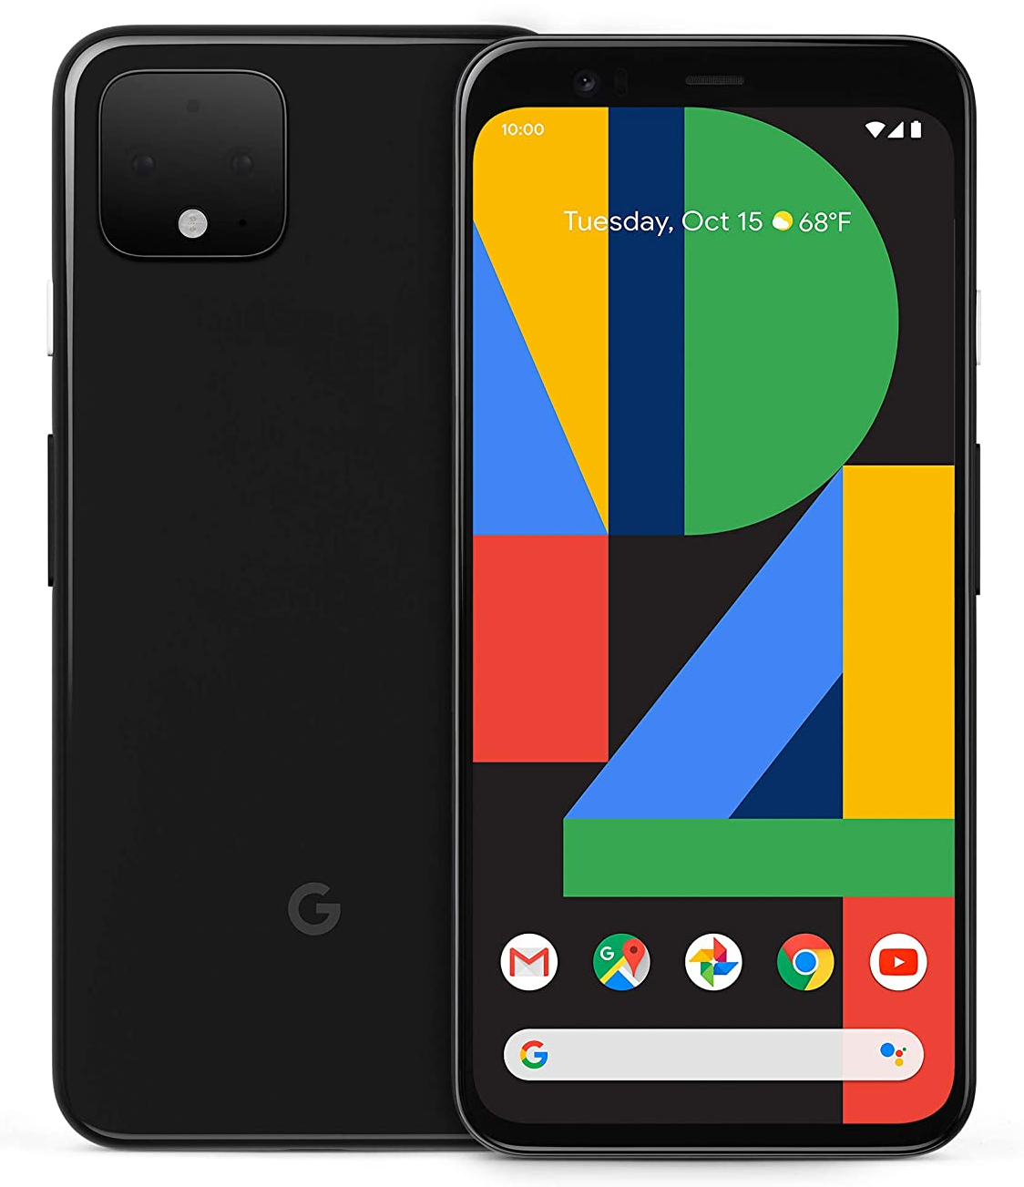
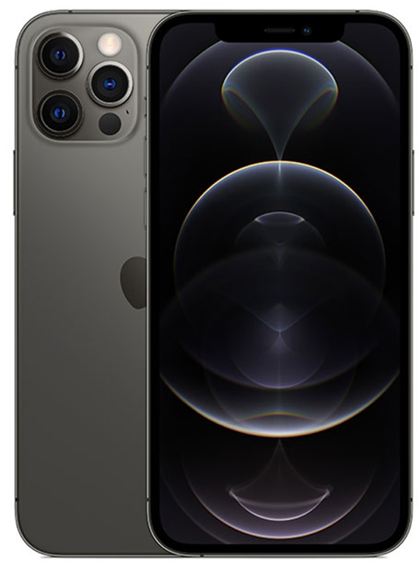
Key Insight
Smartphones are equipped with sensors capable of generating sparse point clouds…
mmWave Radar
Lidar
Leverage these sparse sensing measurements and fuse them with visual techniques to track object’s 6-DoF pose!
Google Pixel 4
iPhone 12 Pro
Notes:
[START] So how FollowUpAR can provide such an excellent AR experience?
We find that today’s commercial smartphones are equipped with sensors capable of generating sparse point clouds.
[CLICK] For example, Google Pixel 4 is equipped with millimeter-wave radar for gesture recognition.
[CLICK] iPhone is also gradually equipped with Laser Radar for enhancing AR experience.
[CLICK] So, our key insight is “Can we leverage these relative sparse sensing measurements and fuse them with camera-based visual techniques to track object’s pose”?

Slide 11
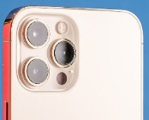
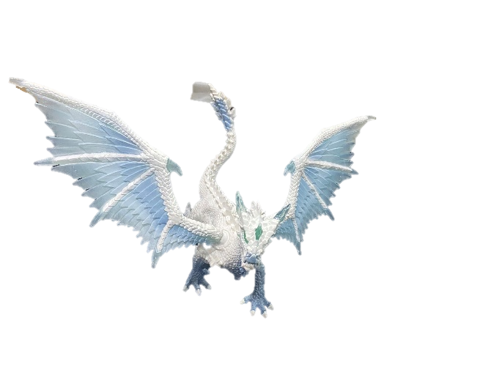

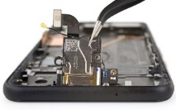

Key Insight
From an intuitive perspective…
Y
6-DoF Pose =
(Translation +
Rotation) * Scale
Z
Normal Dir.
Tangential Dir.
Camera
O
Radar
X
Fusion would overcome the weakness of each sensor!
Notes:
[START] Let’s think about the rationale behind the effective fusion.
[CLICK] the 6-DoF pose can be decoupled as normal translation, tangential translation, rotation, and scale.
Among these four tasks, the camera and radar have their individual advantages.
[CLICK] For example, it’s difficult for a monocular camera to measure depth, but the depth can be easily acquired by a ranging radar.
[CLICK] In contrast, as for the tangential direction, vision based solutions will accurately track objects by pixel or feature points matching.
[CLICK] Further, Vision-based can track the object’s rotation.
However, radar-based solutions sometimes merely treat the whole object as a reflector, hence it is hard for them to calculate the object’s rotation.
[CLICK] But compared with radar, vision-based solutions cannot acquire the absolute scale of the object’s motion. For instance, they do not know how much distance a pixel change in an image represents in the real world.
All in all, we can find that the camera and radar have their individual but complementary advantages.
[CLICK] So our vision is that fusion would overcome the weakness of each sensor and accurately track the object’s pose

Slide 12
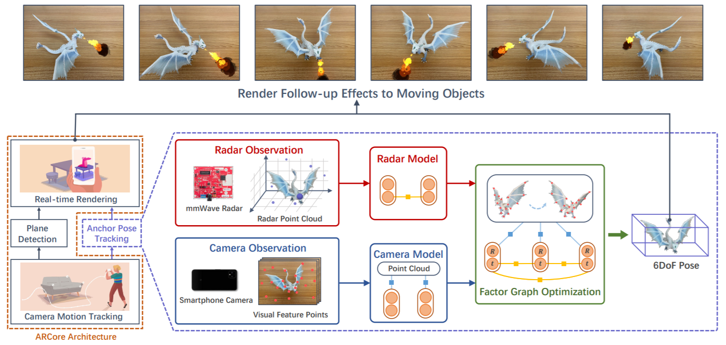
Our Design: Overview
System Overview of FollowUpAR
Notes:
[START] Based on our key insight and vision, we design FollowUpAR.
From a top-view, FollowUpAR provides ARCore with the Anchor Pose Tracking function to track object’s 6 Dof pose.
[CLICK] Let’s step inside, FollowUpAR consists of three key components: mmWave Radar tracking model, camera tracking model and fusion framework.
Although the system architecture seems clear and simple, realize the design is non-trivial
Two major challenges we need to address.

Slide 13
Our Design: Overview
C1: How to track the object’s pose & profile the errors distribution of each module
C2: How to fuse the heterogeneous data
System Overview of FollowUpAR
Notes:
[START] First, how to track the object’s pose, and more important, we also need to answer where the tracking result’s error come from and how to profile its distribution.
The modeling of error distribution actually influences the precision bottleneck.
[CLICK] And second, how to fuse these heterogeneous data?
So in what following, let’s introduce how FollowUpAR overcome these two challenges and realize pose tracking of objects.

Slide 14
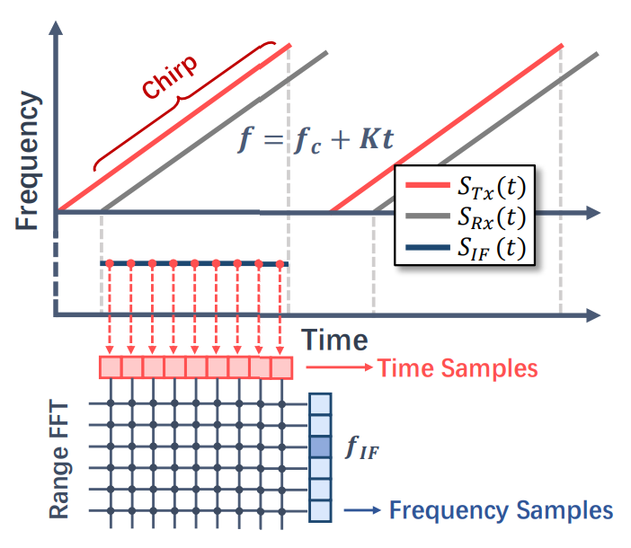
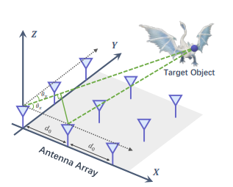
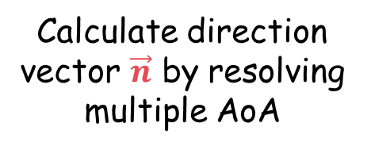

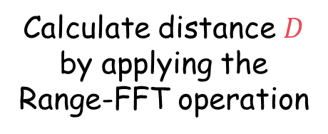
Our Design: Radar Tracking Model
mmWave-radar-based object motion tracking
Y
Z
Calculate distance $D$ by applying the Range-FFT operation
$$D⋅\vec{n}$$
O
X
Calculate direction vector $\vec{n}$ by resolving multiple AoA
Notes:
[START] We first introduce how mmWave radar estimate object’s motion and how to profile its error distribution.
[CLICK] FollowUpAR calculate the distance D as well as its direction vector n from radar to object using the mmWave FMCW signals
[CLICK] Specifically, the D can be calculated by applying the range-FFT operation on the intermediate frequency signal (IF signal)
[CLICK] And the direction vector n can be obtained by resolving multiple AoA

Slide 15


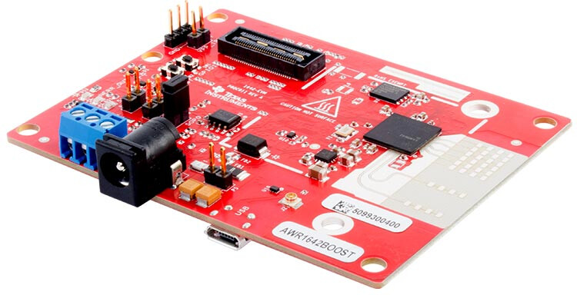
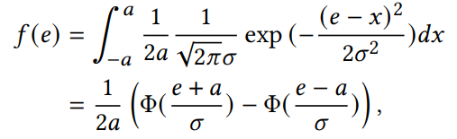
Our Design: Radar Tracking Model
mmWave-radar error analysis from physical-level
Do measurement errors simply follow a Normal Distribution?
We systematically analyze the error distribution from physical-level and propose PRED!
Thermal Noise
PRED: Physical-level Radar Error Distribution¹
AWSG Channels
mmWave Radar
Sampling Error
¹Refer to Section 3.1 and Appendix A in our paper for more details
Notes:
[START] Existing works generally assume the radar error follows a normal distribution.
[CLICK] So is it the truth? If we don’t solve the problem, the following optimization or fusion framework will aim at wrong goals.
[CLICK] Hence in FollowUpAR, we analyse the error distribution of the mmWave radar from a down-to-top perspective.
[CLICK] And we propose the physical-level radar error distribution model.
The PRED model concerns three essential components of the errors: Thermal noise, signal additive white gaussian noise and frequency sampling error.
For more details about the formulation derivation, please refer to our paper.

Slide 16
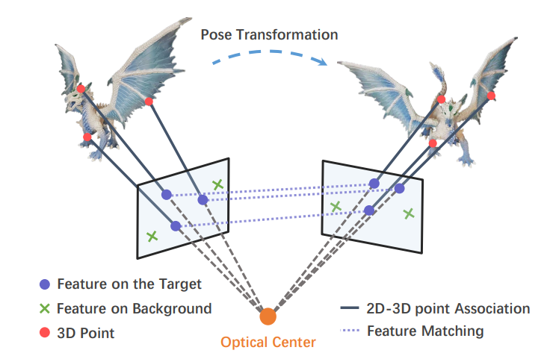
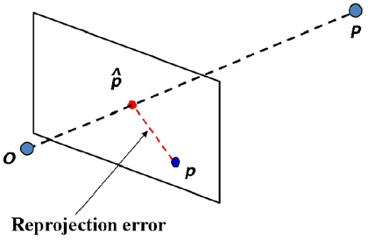
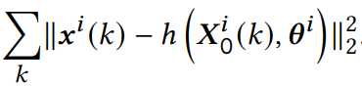
Our Design: Camera Tracking Model
Vision-based object pose tracking & error distribution
Y
Z
O
Error distribution:
Feature point re-projection errors¹
X
Estimate rotation and translation by resolving feature point matching
¹Refer to Section 3.2 and Appendix A in our paper for more details
Notes:
[START]As for the camera tracking model, we design a feature-point-matching based optimization framework,
[CLICK*2] the illustration of the concept is shown in the figure.
[CLICK] We also set the optimization goals of vision-based tracking as minimizing the re-projection errors.
Similarly, in FollowUpAR, we also performs the least square optimization to minimize the error.

Slide 17
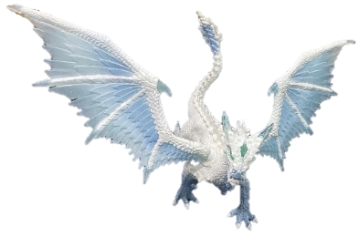
Recall Our Key Insight…
From an intuitive perspective…
6-DoF Pose =
(Translation +
Rotation) * Scale
Precision
Density
Normal Dir.
Tangential Dir.
Design a joint optimization solution instead of a fusion framework!
Camera
Radar
Fusion would overcome the weakness of each sensor!
Heterogeneous data are difficult to fuse!
Notes:
[START] Further, let's introduce how to fuse above two tracking models.
Before presenting our fusion solution, let’s recall our key insight.
Although it’s straightforward to realize that fusion would overcome the weakness of each sensor.
[CLICK] After re-thinking the characteristics of each model, we find that unlike visual features in terms of precision, scale, and density, the sparse point clouds have a relatively low spatial resolution.
[CLICK] Simply using traditional fusion framework such as particle filter will not achieve better performance.
So in followupar, we choose a different concept.
[CLICK] Instead of simply using a fusion framework,
We treat the fusion task as a joint optimization problem and leverage a factor graph to optimize the pose of the object.

Slide 18
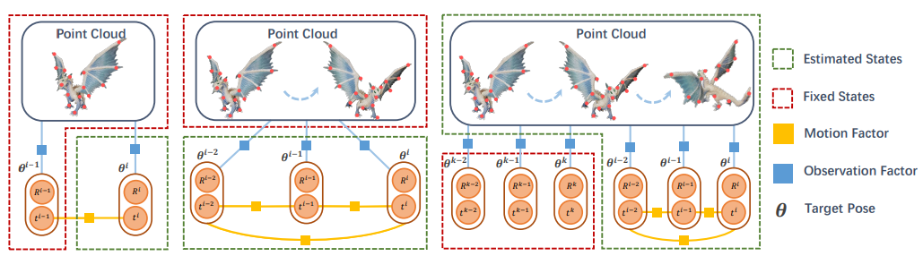
Our Design: Fusion Framework
We fuse camera & radar models by leveraging a Factor-graph-based Joint Pose Optimization framework¹
Joint Pose
Optimization
= Tracking Optimization Module
+ Modeling Optimization Module
Report object’s pose in real-time
Maintain object’s 3D model for long-term & accurate tracking
Inter-frame Tracking
Local Pose Tracking
Object Modeling Optimization
¹Refer to Section 4 and Appendix B in our paper for more details about our designed factor graph
Notes:
[START]Let’s take a look at the factor-graph-based joint pose optimization framework.
[CLICK] The whole optimizations include two parallel tasks: Tracking optimization module and modeling optimization module
[CLICK] The former aims to report object’s pose in real-time according to camera and radar tracking models. It includes short-term inter-frame tracking and long-term local pose tracking.
[CLICK] And the latter is leveraged to maintain object’s 3D model for long-term and accurate tracking.
With a high quality generated point clouds, the tracking quality will also be promoted.
We only illustrate the core concepts here.
For more mathematic details, please refer to our paper.

Slide 19
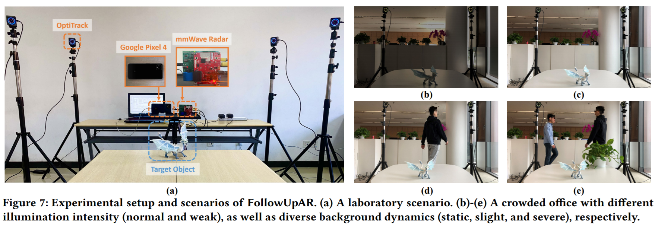
Experiments
Two scenarios with diverse environmental condition
15 hours, 800,000+ frames
Compare with three related works
ICP (A classical visual feature-matching-based tracking algorithm, leveraging RGB-D.)
PoseRBPF (SOTA learning-based solution. Needs pre-training and pre-modeling.)
NOCS (A learning-based solution for category-level object tracking. Needs pre-training.)
Notes:
[START] We implement FollowUpAR on Google Pixel 4.
We conduct experiments in a laboratory and a crowded office, with different illumination intensities and background motions.
We further compare our FollowUpAR with three related systems including a classical visual feature-matching-based algorithm which takes RGB-D data as input.
And two learning-based state-of-the-art solutions, however, these two methods needs complex pre-training.

Slide 20
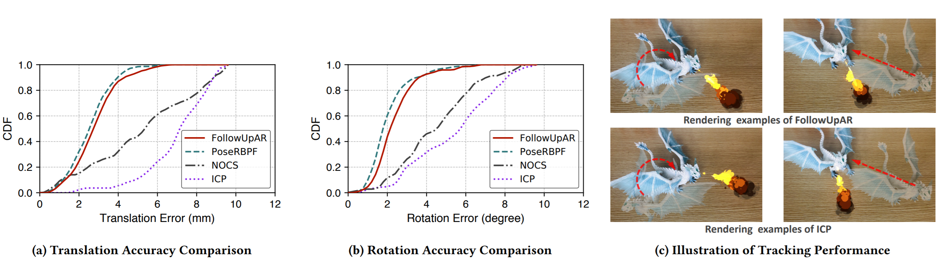
Experiments
Overall Performance
Average translation accuracy: 3.0mm
Average rotation accuracy: 2.6 °
Outperforms two related works and comparable to SOTA learning-based solution
Note that only FollowUpAR can work on smartphones in real-time without complex pre-training or pre-modeling!
Notes:
[START] The evaluation results shows that FollowUpAR achieves an average translation accuracy of 3.0mm and an average rotation accuracy of 2.6 degree. Outperforms the RGB-D based ICP and learning-based NOCS by more than 30%.
The performance is also comparable to the state-of-the-art learning-based solution, PoseRBPF, however, among the related works. Only FollowupAR can track object’s pose in real-time on smartphones.

Slide 21
Experiments
Overall Performance
Note that only FollowUpAR can work on smartphones in real-time without complex pre-training or pre-modeling!
FollowUpAR:
3mm translation error
2° rotation error
ICP:
7mm translation error
6° rotation error
Notes:
[START] We further illustrates a couple of rendering example of FollowUpAR (i.e. 3𝑚𝑚 translation error and 2◦ rotation error) and ICP (i.e. 7𝑚𝑚 tran. error and 6◦ rota. error). As seen, with increased tracking errors for merely 5mm translation error and 4 degree rotation error, the orientation and position of the virtual flame are gradually misaligned, which leaves users the impression of distortion.

Slide 22
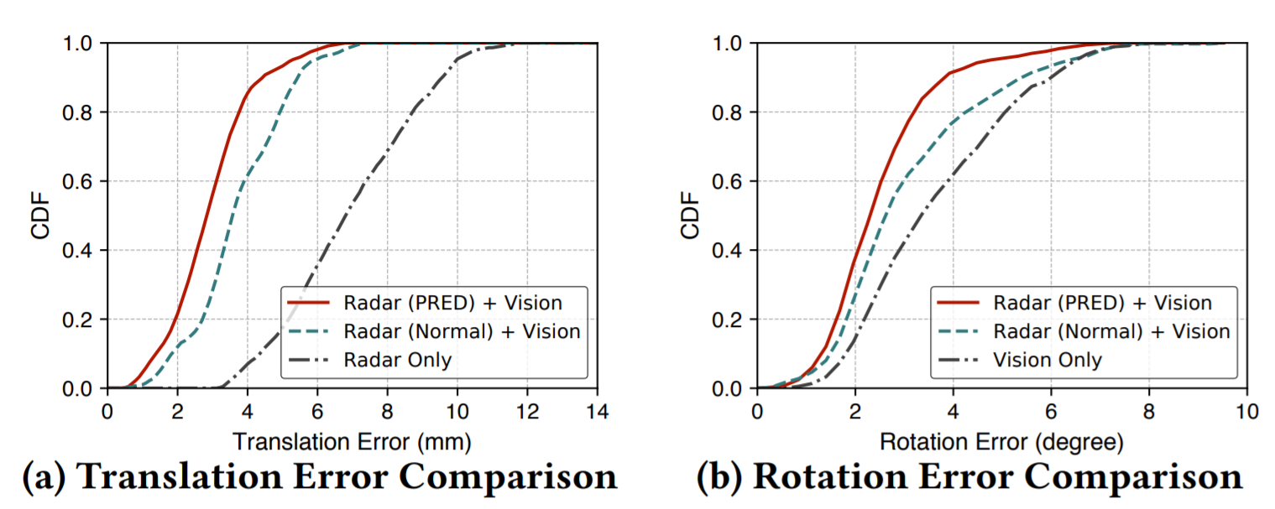
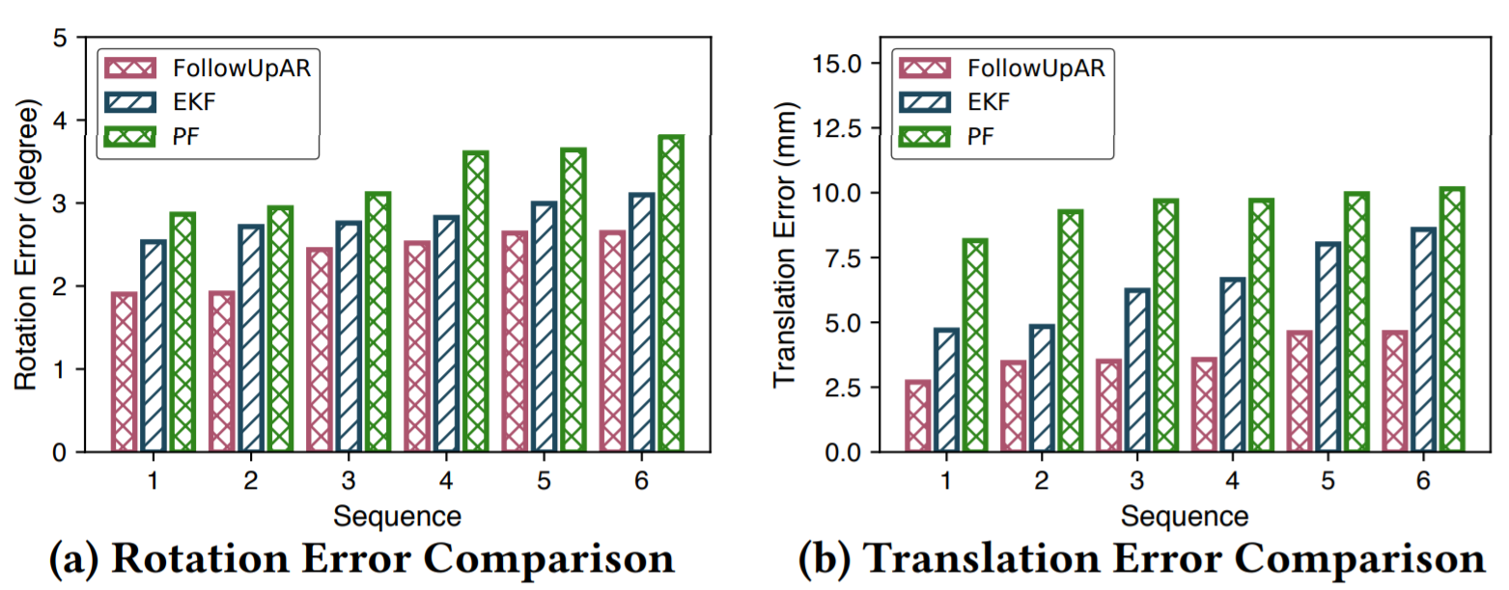
Experiments
System Core Components Study
Fusing Vision and Radar is superior to individual of them (brings about 50% lift).
Our proposed PRED model performs better in the pose tracking (brings about 20% lift).
Our proposed Factor-graph-based Joint Pose Optimization outperforms KF, EKF, PF by > 15%
Refer to Section 5.3 in our paper for more evaluations about our system robustness
Notes:
[START] We further experimentally analyze some core components of FollowUpAR
According to the experiments, we find 1) fusing radar and vision is better than merely use individual of them, and 2) our proposed PRED model performs better in the pose tracking task. Compared with simply treating radar errors as a Gaussian distribution, PRED brings about 20% system performance lift.
[CLICK] The proposed Factor-graph-based Joint Pose Optimization outperforms KF, EKF, PF by > 15%
These outstanding performance, on the one hand, is due to the leverage of the factor graph; on the other hand, lies in our theoretical derivation of the error distribution for radar and camera tracking models

Slide 23
Conclusion
We propose FollowUpAR:
6-DoF object’s pose tracking on smartphones in real-time without complex pre-training or pre-modeling.
Can be integrated into mobile AR frameworks and facilitate smartphones to rend follow-up AR effects to moving objects.
We derive the PRED model:
Push the limit of mmWave radar sensing accuracy.
Explore and reveal the cause of radar error from its hardware design and working principles.
We design a Factor-graph based Pose Optimization framework:
Fuse heterogeneous data with diverse spatial resolution.
Achieve continuous 6-DoF pose tracking for moving objects.
Implement FollowUpAR on commercial smartphones.

Slide 24
Thanks!
Q&A
ARCore
FollowUpAR
Jingao Xu
Tsinghua University
xujingao13@gmail.com
http://jingao-xu.info
Notes:
That's all. Thank you!

Slide 25

Background
Existing Mobile AR Solutions
If the object keeps static, they are good of tracking
user’s/camera’s motion and view virtual effects from any angle
Google ARCore
Google ARCore
Lack the ability to render follow-up effects to moving objects.
Apple ARKit
Apple ARKit
Notes:
[START] Arcore and ARKit are able to continuously track the motion of the smartphone to adjust the location of the virtual effect in the user’s view.
For example, as seen in the demo, when we move the iPhone slowly and keep the cubic stationary, the virtual measurement result will automatically change its location and orientation.
However, once we change the location of these anchor objects, the virtual effects will misalignment and hence the whole view is distorted.
For instance, the virtual flame and measurements do not follow the dragon and cube’s motion.
In a nutshell, today’s mobile AR solutions lack the ability to render follow-up effects to moving objects.

